Slide 1
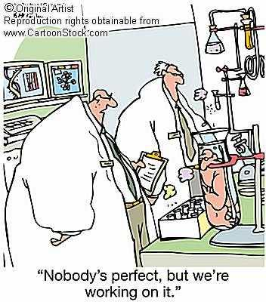
In vitro fertilization –number of eggs Implanted should be limited to reduce harm and chance of Premature birth
Amanda Porter

Slide 2
WHAT IS IN VITRO FERTILIZATION (ivf)?
Process used to treat infertility
Egg and sperm combined in laboratory
Once embryo(s) formed, placed in uterus
Complex and expensive procedure
Never first step in treatment of infertility
5% of couples with infertility seek it out
(Nihira, M., 2009)
Average cost for the procedure is about $12,000

Slide 3
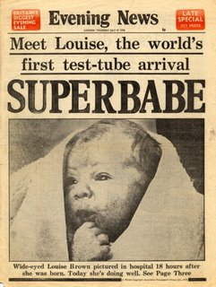
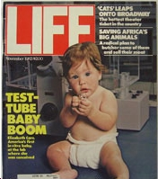
History
1959- Chang achieved IVF births in a rabbit (The History of IVF – the Milestones)
1978- Louise Brown, the first ever IVF birth (Wood)
1979- The Ethics Advisory Board of the U.S. finally approve federal funding on IVF research (Timeline: The History of In Vitro Fertilization)
1980- Joneses’ clinic, America’s first IVF clinic, opens and produces no pregnancies in the first 23 implantations (Timeline: The History of In Vitro Fertilization)
1981- America’s first IVF birth, Elizabeth Comeau (History of IVF, 2004)
2010- Elizabeth Comeau gives birth naturally to her own baby (History of IVF and ART)

Slide 4
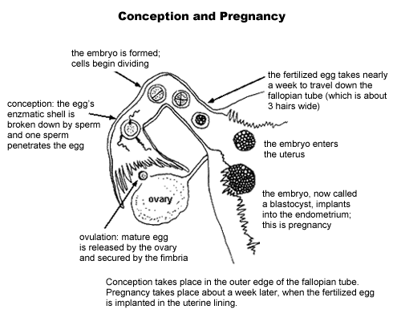
(Singer, 2007)

Slide 5
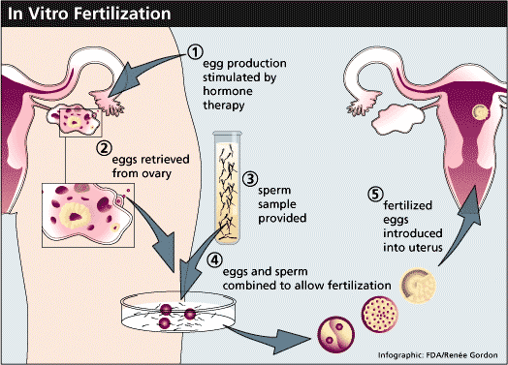
technology
(Dinapoli, 2011).

Slide 6
Human Fertilization and Embryology Act
Established in 1990
Revised in 2008
UK act of parliament, regulation of reproductive technologies (Genetics and Public Policy Procedure, 2010).
Defines meaning of “embryo,” “mother” and “father”
Prohibits implantation of any egg/sperm/embryo that are not defined as “permitted”
http://www.legislation.gov.uk/ukpga/2008/22/contents

Slide 7
Human Fertilization and Embryology Authority (HFEA)
Established because of HFE Act
Regulates/inspects clinics providing in vitro fertilization, artificial insemination, and the storage of human eggs, sperm, or embryos (Wikipedia, 2011)
Licensing authority responsible for the licensing of persons involved in activities, supervising research carried out on human embryos, and reviewing the resulting information” (Research Machines plc, 2009)

Slide 8
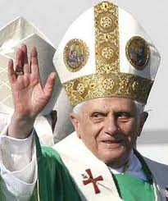
Pope Benedict XVI
In 2006, Pope Benedict XVI publically announced that he was against artificial ways of fertilization
“Dignitatis Personae (the dignity of the person)” is speaking against recent technological developments (Caldwell, 2008).
Stresses that natural reproduction is the right and only way, saying that we are playing God by doing work that should be done by God only (Marsh)
Showed he was against “artificial fertilization, designer babies, embryonic stem-cell research, human cloning and drugs which block pregnancy from taking hold” (Caldwell, 2008)
Calls these new technologies ‘immoral’ and a ‘sin’

Slide 9
My stance – the issues
Too many eggs are implanted in the womb, risks of premature births are high
Single embryos-39 or 40 weeks to grow to full maturity. Twins-35 weeks. Triplets-33 weeks.
Life-long health problems like cerebral-palsy, birth defects or disabilities
40–60% of IVF twins need to be transferred to the intensive care. Only 20% of singleton IVF babies need the same level of care (Risks to the Child)
Premature and low birth weight infants could also be subject to illnesses such as Attention Deficit Hyperactivity Disorder, or even problems with language development (Risks to the Child)

Slide 10
HFEA & the issues of IVF
HFEA suggest that multiple births are the “single biggest health risk” concerning treatments of infertility (Multiple Births – A Statistical Report, 2011).
Reports other harmful issues to the infant and the mother from multiple eggs implanted: higher risk of miscarriage, premature and low birth weight infants, and increased risks of death in first 3 months of infant’s life (Improving Outcomes for Fertility Patients: Multiple Births, 2011).
Pushing for single embryo transfers only
Plan to decrease multiple pregnancies from 24% in 2008 to 15% in 2012 (Improving Outcomes for Fertility Patients: Multiple Births, 2011)

Slide 11
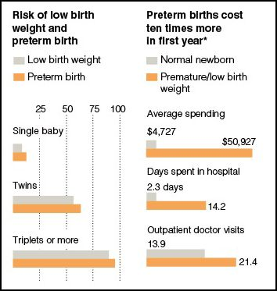
(Wade, 2009).

Slide 12
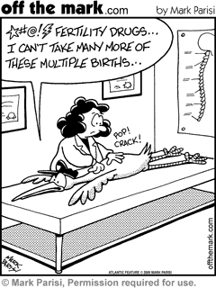
future
Laws
More research
American Society for Reproductive Medicine (ASRM) ‘patient fact sheet’ that discusses the risk and harms to multiple pregnancies (Patient Fact Sheet: Risks of In Vitro Fertilization, 2007).
Recently the ASRM held a meeting to report “calling for an increase in the use of elective single embryo transfer (SET) in good prognosis patients undergoing in vitro fertilization (IVF) (Younger, Nicoll, & Tipton, 2011).

Slide 13
references
Caldwell. (2008). Pope Condemns 'Immoral' Bio-Science Such as IVF and Designer Babies as a Threat to Life. Retrieved from http://www.dailymail.co.uk/news/article-1094219/Pope-condemns-immoral-bio-science-IVF-designer-babies-threat-life.html#ixzz1bNjA6Xam
Dinapoli, M. (2011, July 7). Helping Woman Get Pregnant. Retrieved from http://blog.timesunion.com/mdtobe/helping-women-get-pregnant/1373/
(2011). Improving Outcomes for Fertility Patients: Multiple Births. Retrieved from http://www.hfea.gov.uk/docs/2010-05-18_-_Multiple_Births_Publication_2011_-_Rationalising_Register_Data_-_FINAL_1.pdf
Marsh. (n.d.). IVF Limit To Cute Multiple Birth. Retrieved from http://www.dailymail.co.uk/health/article-205381/IVF-limit-cut-multiple-births.html
(2011). Multiple Births – A Statistical Report. Retrieved from http://www.hfea.gov.uk/6456.html
Nihira, M. (2009). Infertility and In Vitro Fertilization. Retrieved from http://www.webmd.com/infertility-and-reproduction/guide/in-vitro-fertilization
(2007). Patient Fact Sheet: Risks of In Vitro Fertilization (IVF). Retrieved from http://www.asrm.org/uploadedFiles/ASRM_Content/Resources/Patient_Resources/Fact_Sheets_and_Info_Booklets/risksofivf.pdf
(n.d.) Risks to the Child. Retrieved from http://www.oneatatime.org.uk/38.htm
Singer, K. (2007). The Garden of Fertility: Reproductive Health, Fertility Awareness and Natural Family Planning. Retrieved from http://www.gardenoffertility.com/reprofemale.shtml
Wade, L. (2009, October 19). The Cost of In Vitro Fertilization. Retrieved from http://thesocietypages.org/socimages/2009/10/19/the-cost-of-in-vitro-fertilization/
Younger, B., Nicoll, E., & Tipton, S. (2011). Expert Calls for Increase In Single Embryo Transfer. Retrieved from http://www.asrm.org/news/article.aspx?id=7277&terms=%28+%40Publish_To+Both+Sites+or+%40Publish_To+ASRM+Only+%29+and+in+vitro+fertilization
(2004). History of IVF. Retrieved from http://lifesourcefertility.com/history.html
(n.d.). History of IVF and ART. Retrieved from http://www.ivf-lings.co.nz/The-History-of-IVF.aspx
(n.d.) The History of IVF – the Milestones. Retrieved from http://www.ivf-worldwide.com/ivf-history.html#top
(n.d.) Timeline: The History of In Vitro Fertilization. Retrieved from http://www.pbs.org/wgbh/americanexperience/features/timeline/babies/1/
Wood, C. (n.d.) IVF Timeline. Retrieved from http://www.ivfmeds.com/aboutivf/
(2009). Research Machines plc. Retrieved from http://encyclopedia.farlex.com/Human+Fertilization+and+Embryology+Act
(2011). Wikipedia – Human Fertilization and Embryology Authority Retrieved from http://en.wikipedia.org/wiki/Human_Fertilisation_and_Embryology_Authority
(2010). Public Policy Center –Genetics and Public Policy Genter. Retrieved from http://www.dnapolicy.org/policy.international.php?action=detail&laws_id=62

